Slide 1
Lecture-9
British Colonial rule

Slide 2
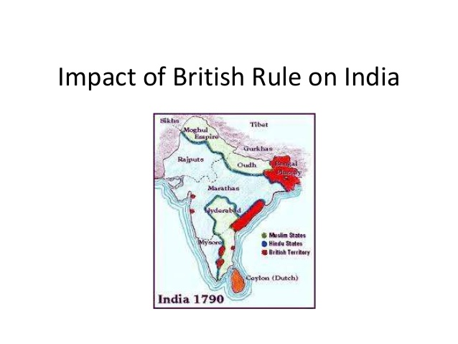

Slide 3


Slide 4


Slide 5
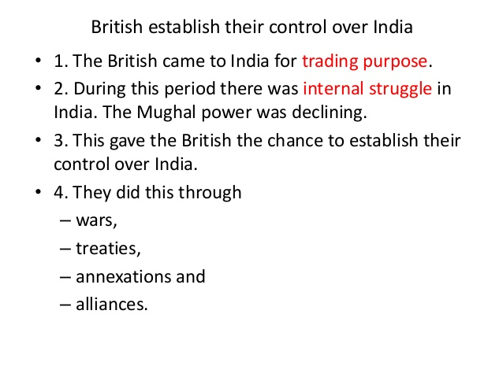

Slide 6
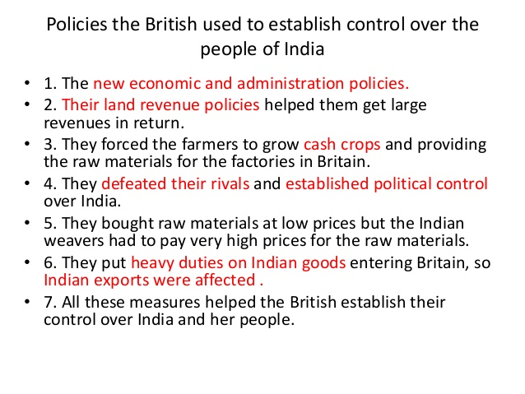

Slide 7


Slide 8
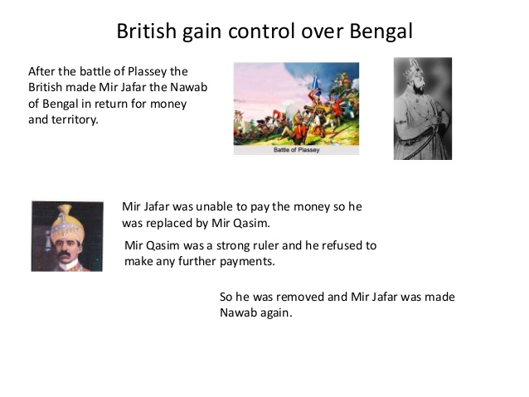

Slide 9
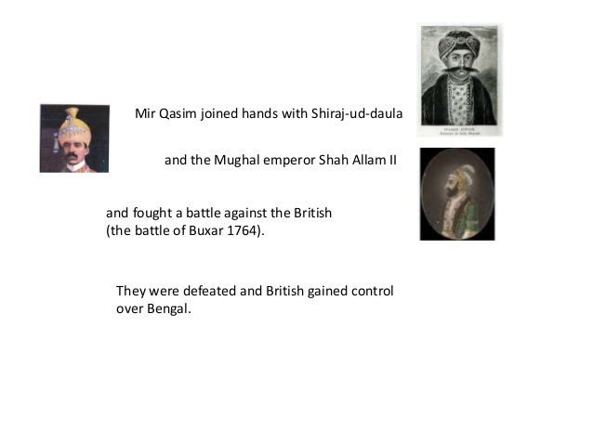

Slide 10
Economic impact
of
British rule in Bengal

Slide 11


Slide 12


Slide 13
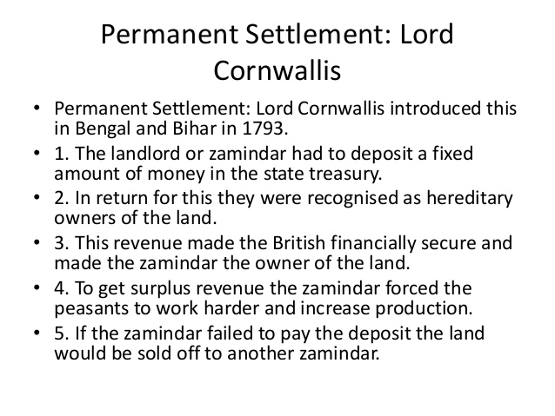

Slide 14


Slide 15


Slide 16


Slide 17
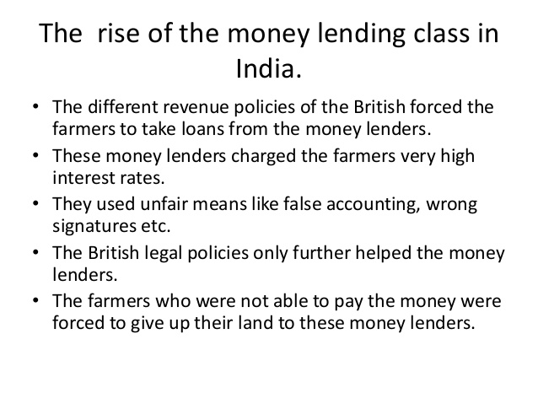

Slide 18


Slide 19


Slide 20
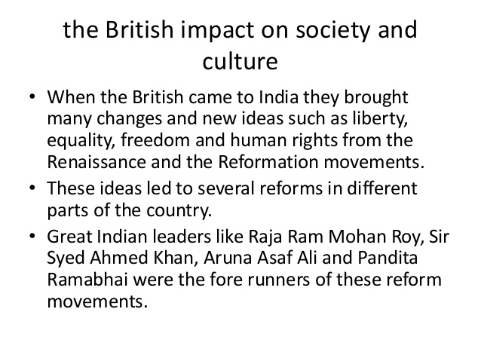

Slide 21
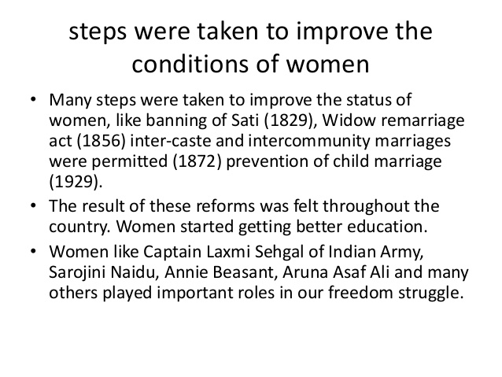

Slide 22


Slide 23
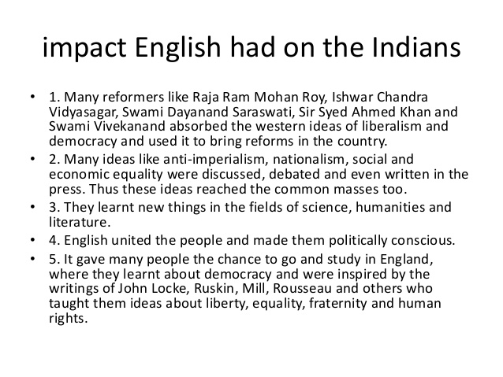

Slide 24


Slide 25
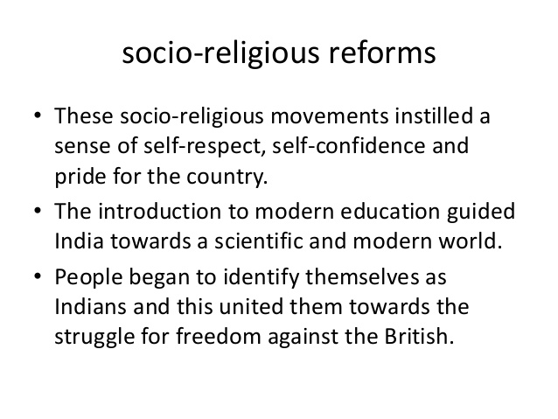

Slide 26
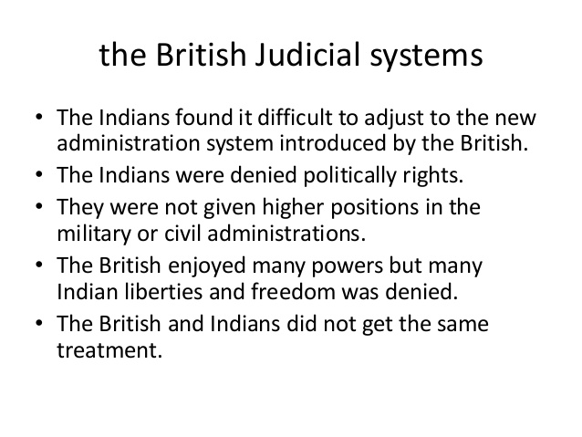

Slide 27
Introduction of Democracy
Britain introduced a lot of good things to India- democracy, for one thing. Before British rule, India was governed by the Mughal Emperors, who were effectively dictators. The British introduced a system of multi-party democracy for India's various state councils and regional legislatures, whereby the people's representatives were elected by popular vote.
In short, Britain brought India into the modern world of the 19th / 20th Centuries, raising it from the Mediaeval trough of feudal domination it had been languishing in beforehand, and creating a new, humane and advanced system of running a nation. The British also abolished some of the barbaric practices that were rife beforehand, such as that of burning a man's wife to death when he himself died.

